Slide 1

Suraksha
A Band of Strength, A Bond of Security

Slide 2

What is Suraksha?
Suraksha is a dual-solution safety system combining the Suraksha Wristband “Curetta” with a discreet SOS button and the Suraksha App. A single press alerts emergency contacts, shares live location, and notifies authorities in seconds.

Slide 3
Features
SOS Alert System
Location Tracking
A single press on the wristband sends an SOS alert to the app, notifying your emergency contacts and sharing your real-time location to ensure help arrives quickly.
Suraksha uses GPS technology to provide real-time tracking only when needed, ensuring your location remains private unless an emergency arises
Silent Alarm
Seamless Connectivity
Suraksha enables discreet alerts without any noise or light, ensuring users can send SOS signals quietly when silence is essential.
The wristband seamlessly pairs with the Suraksha app, ensuring alerts are sent instantly, even in low-signal areas.

Slide 4

How is Suraksha different
Personal AI
Suraksha’s AI assistant, Cypher, steps in to guide users and provide support in situations where human help isn’t immediately available.

Slide 5

How is Suraksha different
Personal AI
Live Audio
Suraksha’s AI assistant, Cypher, steps in to guide users and provide support in situations where human help isn’t immediately available.
Suraksha's live audio recording captures real-time sounds during emergencies, providing crucial evidence and enhancing user safety.

Slide 6

How is Suraksha different
Personal AI
Live Audio
Geofence Guardian
Suraksha’s AI assistant, Cypher, steps in to guide users and provide support in situations where human help isn’t immediately available.
Suraksha's live audio recording captures real-time sounds during emergencies, providing crucial evidence and enhancing user safety.
Suraksha's geofencing technology creates virtual safety zones, triggering automatic actions when users enter or exit predefined areas.

Slide 7

How is Suraksha different
Personal AI
Live Audio
Geofence Guardian
Crisis Compass
Suraksha’s AI assistant, Cypher, steps in to guide users and provide support in situations where human help isn’t immediately available.
Suraksha's live audio recording captures real-time sounds during emergencies, providing crucial evidence and enhancing user safety.
Suraksha's geofencing technology creates virtual safety zones, triggering automatic actions when users enter or exit predefined areas.
Suraksha guides users to nearby police stations and hospitals, offering vital support and swift navigation in emergencies

Slide 8
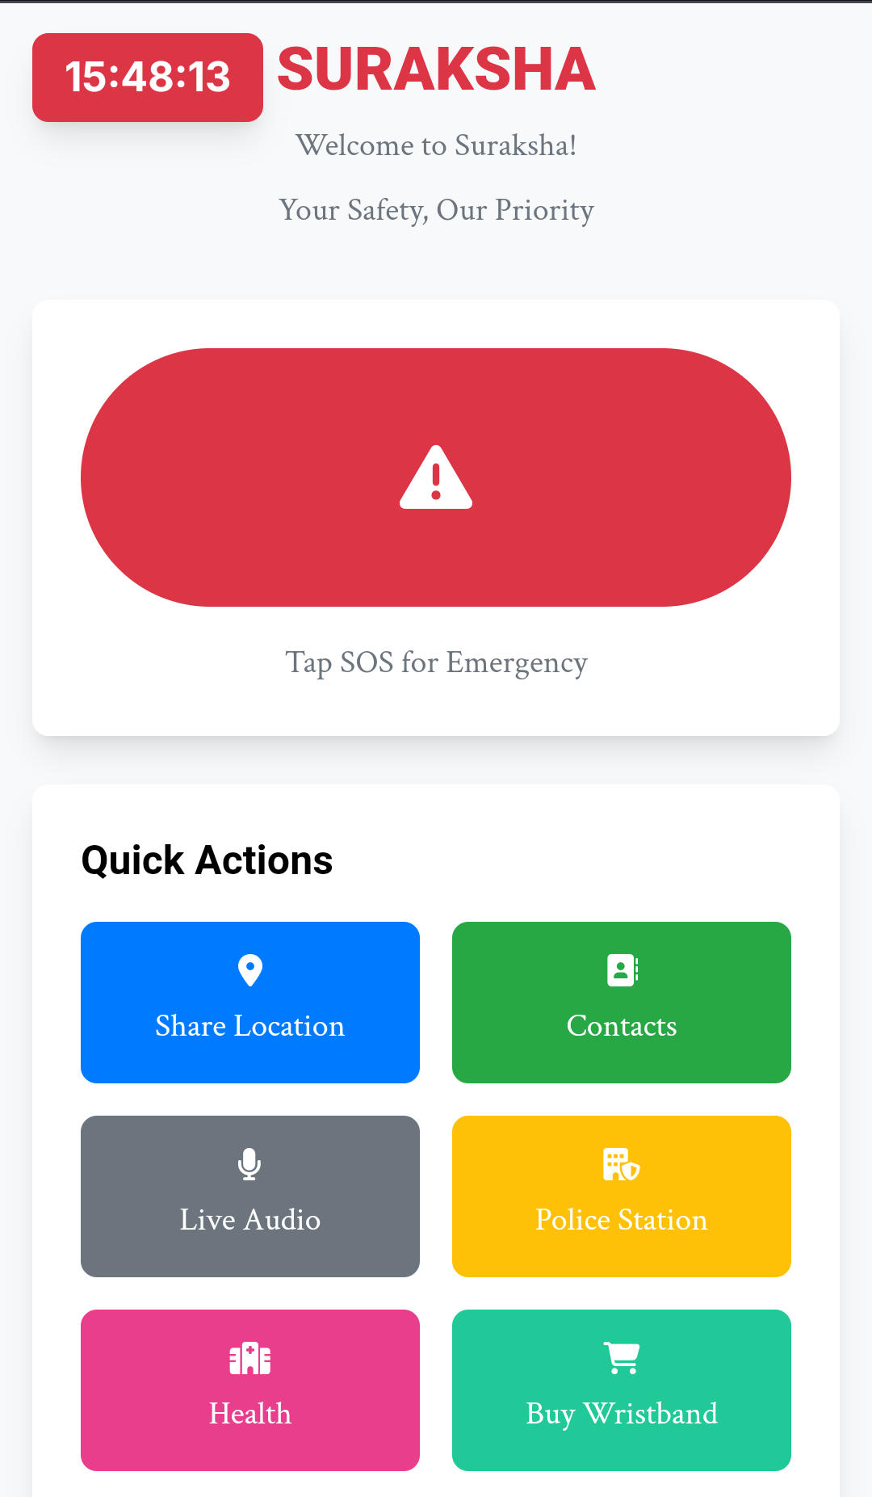
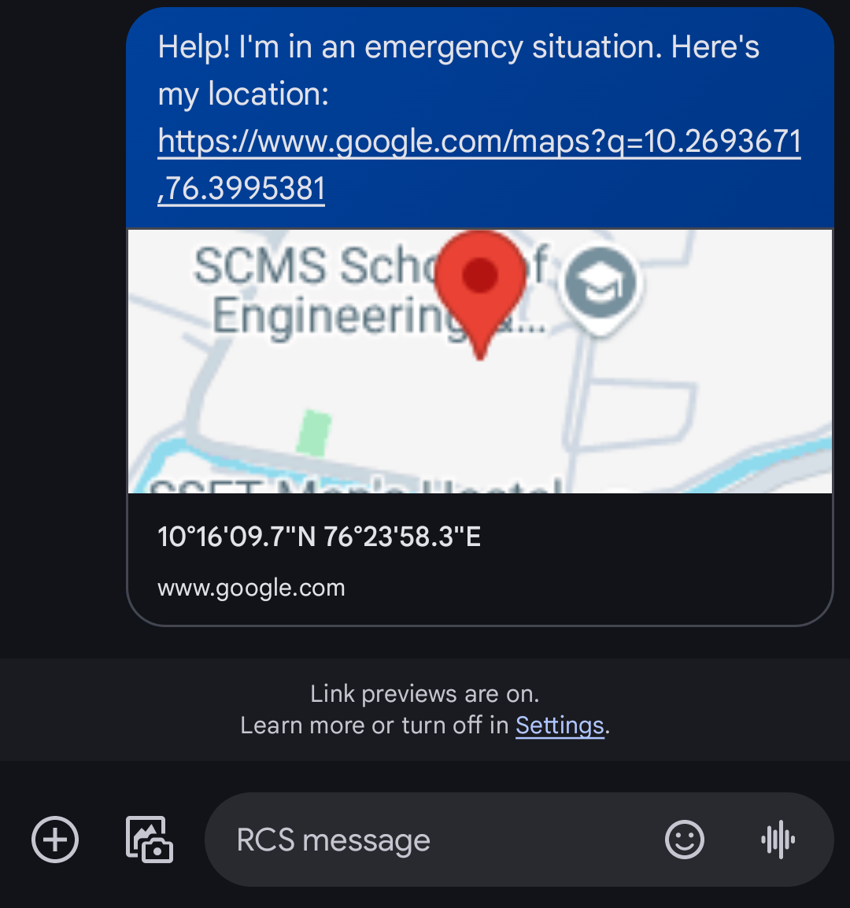
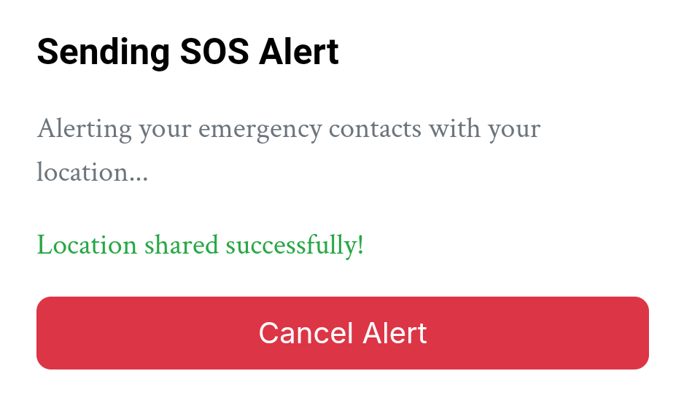
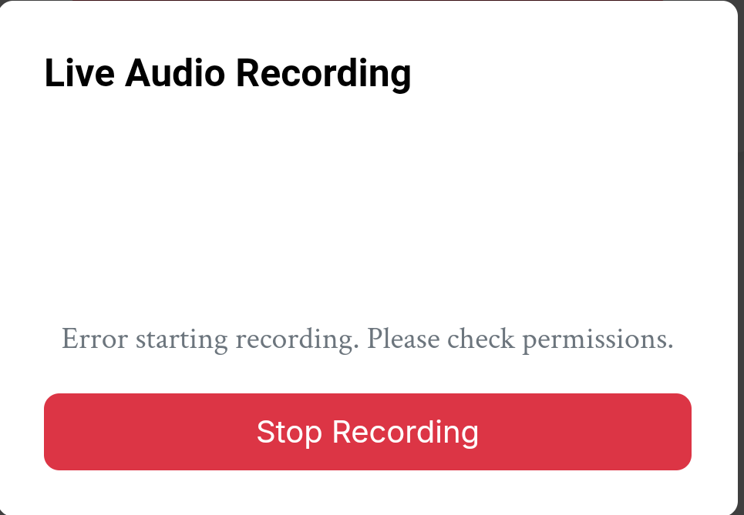
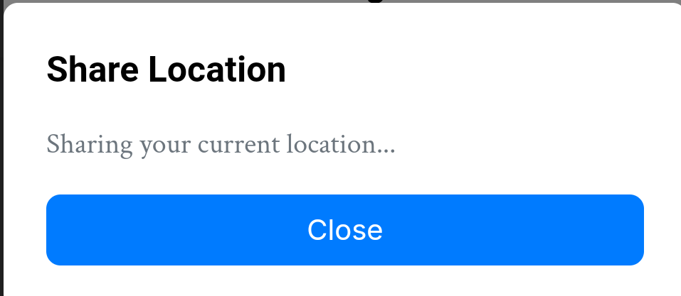
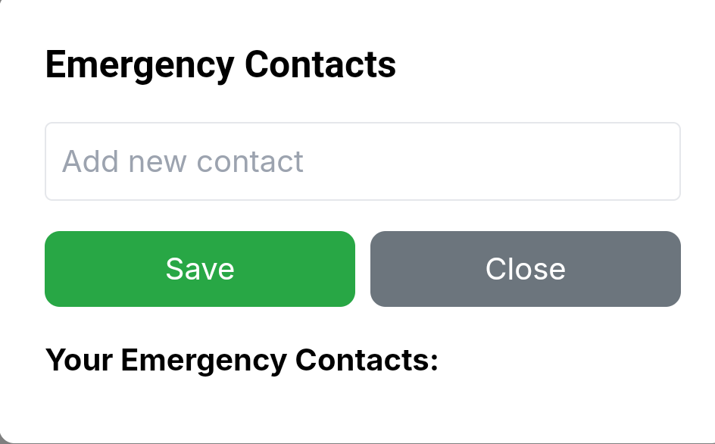
How Suraksha will look like

Slide 9




Product Overview
Unique
First to market
Our Wristband “Curetta” is Very Stylish unlike our competitors who focus more on functionality
First beautifully designed product that's both stylish and functional​
Tested
Authentic
Conducted testing with School students in the area​
Designed with the help and input of experts in the field ​

Slide 10
Product Benefits
Cool and stylish product​
User Empowerment
Emergency Navigation

Slide 11
Our competition
Suraksha
competitors
Our product is priced below that of other companies on the market​
Design is stylish and easy to use, compared to the complex designs of the competitors​
Affordability is the main draw for our consumers to our product​
Sonata Act Product will stop working if a phone is not within range​
Relyeon Product is expensive and inconvenient to use​
Sekyo ​ Product is affordable, but inconvenient to use

Slide 12
Our competition graphic
convenient
SURAKSHA
Sonata
expensive
affordable
Sekyo
Relyeon
Inconvenient​

Slide 13
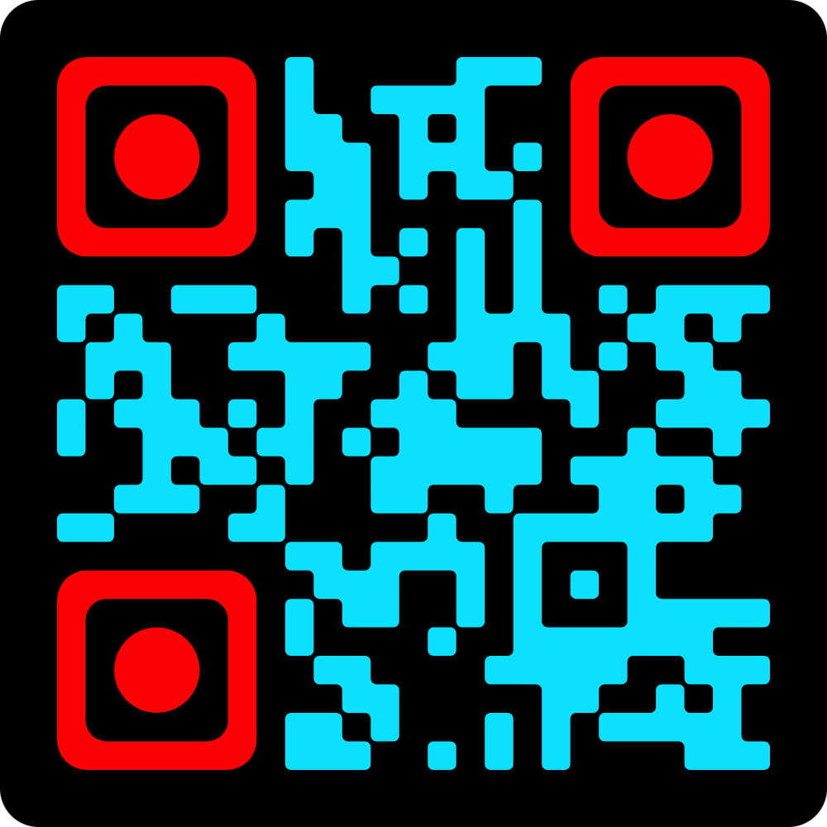
Try our app For yourself

Slide 14
Thank you

